Slide 1
BGS
Mentorship Workshop
By BGSA
August 18th 2020

Slide 2
Mentorship Workshop Itinerary
Timeline | Activity | Leader(s)
2:00-2:05 | Overview of Program | Gabriela
2:05-2:30 | Listening Skills & Enhancing Communication | Student Volunteers
2:30-3:30 | Case Studies (15 minutes each) | Student Volunteers
3:30-3:35 | Bathroom & Stretch Break | ---
3:35-4:05 | Mentorship Panel of Current PhD Students | Mentor Panel
4:05-4:10 | Concluding Remarks | Gabriela
Key:
Large Group Session
Small Group Session
Notes:
Overview of Program: Gabriela (5 min) 2:00-2:05
Listening Skills & Enhancing Communication (25 min) 2:05-2:30
Case Studies (1 hr) 2:30-3:30
Aligning Expectations (15 min)
Finding a Mentor (15 min)
Effective Communication (15 min)
Fostering Independence (15 min)
Bathroom & Stretch Break (5 min) 3:30-3:35
Mentorship Panel of Current PhD Students (30 min) 3:35-4:05
Pre-sent in Questions about Mentorship (20 min)
Open Forum Q&A (10 min)
Concluding Remarks: Gabriela (5 min) 4:05-4:10
Follow up email with resources

Slide 3
Transition to Small Break Out Sessions
9-10 participants per group
1 moderator
(Thank you AV Team!)

Slide 4
Listening Skills & Enhancing Communication
Take a few minutes to identify your Constructive and Deconstructive behaviors
Introduce yourself by sharing the following:
Name
BGS program
Career/Research interests
Something about yourself (hobby, fact, new/unique skill)
Constructive/Destructive behavior (following slides will guide you)
Before you start state the name of the person before you and their constructive behavior.
Ex: “It is nice to meet you Laura. I admire that you are a harmonizer.”
Notes:
Explain the exercise
Let them know they will have 3-5 min to to read through the definitions.
While the students are reading the slides write down their last names in alphabetical order so you have list of names
You can leet them know to write down answears in the chat

Slide 5
Identify your Constructive Group Behavior
Cooperating: Is interested in the views and perspectives of other group members and willing to adapt for the good of the group.
Clarifying: Makes issues clear for the group by listening, summarizing, and focusing discussions.
Inspiring: Enlivens the group, encourages participation and progress.
Harmonizing: Encourages group cohesion and collaboration. For example, uses humor as relief after a particularly difficult discussion.
Risk Taking: Is willing to risk possible personal loss or embarrassment for success of the overall group or project.
Process Checking: Questions the group on process issues such as agenda, time frames, discussion topics, decision methods, use of information, etc.
Notes:
5 min to read and identify your behaviour

Slide 6
Identify your Deconstructive Group Behavior
Dominating: Uses most of the meeting time to express personal views and opinions. Tries to take control by use of power, time, etc.
Rushing: Encourages the group to move on before task is complete. Gets tired of listening to others and working with the group.
Withdrawing: Removes self from discussions or decision making. Refuses to participate.
Discounting: Disregards or minimizes group or individual ideas or suggestions. Severe discounting behavior includes insults, which are often in the form of jokes.
Digressing: Rambles, tells stories, and takes group away from primary purpose.
Blocking: Impedes group progress by obstructing all ideas and suggestions. "That will never work because..."
Notes:
5 min to read and identify your behavior

Slide 7
Listening Skills & Enhancing Communication
Now that you have identified your Predominant Constructive and Deconstructive Behaviors, keep each other accountable and involved!
Introduce yourself by sharing the following:
Name
Career/Research interests
Something about yourself (hobby, fact, new/unique skill)
Constructive/Destructive behavior (refer to previous slides for guidance)
Before you start state the name of the person before you and their constructive behavior.
Ex: “It is nice to meet you Laura. I admire that you are a harmonizer.”
Notes:
Moderator will go first
Then in alphabetical order

Slide 8
Case Studies
These case studies were chosen to initiate conversations about mentoring between students, faculty, and your future thesis mentor(s).
You do not need to answer every question, these are merely to start conversation and discussion.
Notes:
We will need one volunteer to read the case
One volunteer to kepp track of the time : 15 min per case
One volunteer to keep track of important questions students ask- these can be asked later on during panel session

Slide 9
Request for Student Volunteers:
Time Keeper - Someone to check the time and remind the group when it is time to move onto the next case study
Note Taker - someone to write down questions to submit to mentorship panel, that are not answered or addressed during the case study discussions

Slide 10
Case Study 1: Finding a Mentor
Alicia is a first year student who has rotated in multiple labs. She did not take much time interviewing the PI or lab prior to her rotations, and regrets it deeply. Her first rotation mentor had multiple rotation students, but only accepts one student a year and has filled the position. Her second rotation PI let her know that she does not have the space for her to join the lab after she completed her rotation. She is still in the midst of her third rotation and is concerned that the lab has a toxic work environment since research projects are valued over the people in the lab. She suspects this because everyone works long hours in the lab and when she went to grab coffee with the fourth year graduate student in the lab, they mentioned that they felt burnt out. Alicia is concerned that she has not found an appropriate thesis lab nor PI mentor, and that she has to join her third rotation lab. She is not sure what to do since she was supposed to join her thesis lab by the June deadline.
Guiding Questions:
Should Alicia have asked about funding and open spots in the lab prior to her rotations?
Who could Alicia have contacted prior to her rotations to learn more about the work environment in the lab and the mentors?
What are some important things to consider when looking for a thesis lab? How can you prioritize these items when meeting with potential rotation PIs and labs?
What are Alicia’s options now?
Who can she contact to discuss her options?
[Suggested answers are in the notes for reference.]
Notes:
Guiding Questions:
Should Alicia have asked about funding and open spots in the lab prior to her rotations? Yes! This is a very important question to ask. Although you are financially supported by your program for the first two years of graduate school in CAMB, the following years are financially supported by your PI’s budget. You should be able to ask about what funding the PI has for you short-term (ex: K99/R00, start up funds, society grants) and long term (ex: R01) to support your stipend and PhD training.
Who could Alicia have contacted prior to her rotations to learn more about the work environment in the lab and the mentors? Everybody else in the lab-postdoc, grad students, other individuals who have graduated or left already
What are some important things to consider when looking for a thesis lab? How can you prioritize these items when meeting with potential rotation PIs and labs? “What are the most important things to you? Where can you thrive?” Environment, funding, lab size, mentoring style, lab techniques used, research project, openness to alternative career paths Best fit
What are Alicia’s options now?
Alicia can do a fourth rotation. She should have the opportunity to make a decision between 2-3 labs and not just one to ensure she is joining the lab she can thrive in during her graduate studies.
Who can she contact to discuss her options? Other advisors, faculty, grad students: upperclassmen, chair of the program, etc.

Slide 11
Case Study 2: Aligning Expectations
During your rotation you noticed that you haven’t met with your PI yet, besides meeting them on your first day in the lab. When you ask people in your lab if this is usual for graduate students they say it is abnormal, and that they typically meet with graduate students who have joined the lab more frequently. However, when you ask one of the graduate students in the lab they say it is normal to meet with their PI only every few months. When you finally do meet with your PI, they ask you for an agenda and to see your results and lab notebook, but you were not aware you should have made an agenda or brought these items to the meeting. Your meeting was scheduled to be 30 minutes, but only lasted 10 minutes due to your PI’s frustration. You are very confused, as no one in the lab warned you about this and these expectations were not discussed previously to this meeting.
Guiding Questions:
How often should you meet with your rotation PI? What about your thesis advisor?
Do you think this mentor has trouble aligning expectations with other members of the lab? If so, why? How can you notice this as a potential issue in the future?
How can you align expectations with your rotation PI? Will this be different with your thesis advisor, or similar?
Who else can you ask for mentorship and guidance in the lab besides your PI?
Do you think “mentoring-up” by creating an agenda for your 1:1 meetings would be helpful for future meetings? If so, what would you include in this agenda?
[Suggested answers are in the notes for reference.]
Notes:
Suggested Answers
Guiding Questions:
How often should you meet with your rotation PI? What about your thesis advisor? As often as you need to, permitting your mentor is available. Upperclassmen will recommend to meet with your PI early (in you training) and often. While starting your PhD you may need to meet with your PI weekly or bi-weekly to get the feedback necessary to stay on track, but as you develop as a scientist you may discuss your project more with other scientists such as your thesis committee, collaborators, or lab members. The most important thing to keep in mind, is that meeting with your PI is important, so keep an open line of communication between you two.
Do you think this mentor has trouble aligning expectations with other members of the lab? If so, why? How can you notice this as a potential issue in the future? Absolutely! There is some definite communication breakdowns in the lab, and some issues with aligning expectations with lab members. What is most likely is, that this could be due to an expectation to pass down information between lab members, or the PI is simply very busy and thought they had communicated these expectations to you. No matter why, you should let them know that you were unaware of these expectations. You can notice this if you interview a PI prior to your rotations and ask them about the lab culture, and then interview the lab separately asking the same or similar questions to see if these expectations align and if the communication is homogeneous. If it is not, this will indicate that there may be communication issues or misaligned expectations in the lab.
How can you align expectations with your rotation PI? Will this be different with your thesis advisor, or similar? You can align expectations by communicating often, finding a mentor that has time for you and your training, and by having agendas prior to meetings or summary statements after meetings that you both read, discuss, and agree upon.
Who else can you ask for mentorship and guidance in the lab besides your PI? Lab members, especially older members such as post-doctoral fellow and senior scientist are great resources for mentorship and guidance! Neighboring labs also have lab members that could help you with experiments or equipment. Upperclassmen graduate students are a greatly underutilized resource for mentorship. Don’t hesitate to reach out to them by email to ask for assistance or to meet (virtually due to COVID restrictions).
Do you think “mentoring-up” by creating an agenda for your 1:1 meetings would be helpful for future meetings? If so, what would you include in this agenda? Mentoring up is the process of telling your PI exactly what you need directly. Agendas are a great way to find mentors that are open to you telling them what you need and help you align expectations of what is expected of you in the lab. Agendas should include previous results for discussion, issues had with experiments to discuss troubleshooting options, and future experiments to discuss experimental design and resources needed for these future experiments to start planning them. You can also put personal items such as lab issues, vacation time, grant applications and deadlines you would like to apply to, and professional conferences you would like attend in these agendas to better communicate your interests. These are just a few examples, but this is a great way to articulate yourself and have a record that you communicated these things to your PI.

Slide 12
Case Study 3: Effective Communication
When you meet with your PI, they often talk very quickly and you miss components of your newly developing project that are important to know and understand to start to think independently about your project. This requires them to repeat themselves throughout the meeting and at the subsequent meetings. They are starting to get frustrated with you, since they have to keep repeating themselves. To add to the frustration, you are also getting irritable. After emailing your PI multiple times without response, you find out that they have been using slack with the rest of the lab, but they did not properly add you to the slack channel. Then, they mention that the individuals in the lab have the protocols in their virtual lab notebooks, but you have not been able to find any of them typed up online. Instead, you have to ask the lab members directly to see their lab notebook protocols, which is not what the PI expects of them in the lab based on your previous discussions.
Guiding Questions:
What can you do to make sure you are assessing your own understanding of what is happening in these meetings?
What resources can you ask your PI to provide to you to learn and understand this information that is pertinent to your project that they are speaking about during your meetings?
When should you discuss communication preferences with your PI?
How can you improve communication with your PI?
Whose responsibility is it to ensure there is effective communication in the lab?
[Suggested answers are in the notes for reference.]
Notes:
What can you do to make sure you are assessing your own understanding of what is happening in these meetings? Take notes during the meeting/record. Communicate more your concerns with PI and ask a lot of questions.
What resources can you ask your PI to provide to you to learn and understand this information that is pertinent to your project that they are speaking about during your meetings? Papers, perhaps set up meetings with each member of the lab whenever they have time to get a better understanding etc.
When should you discuss communication preferences with your PI? Easier to do in the very beginning during the first initial meetings
How can you improve communication with your PI? Ask about their preferences/method of communication and lay out both your expectations earlier on.
Whose responsibility is it to ensure there is effective communication in the lab? Everybody’s-yours, PIs,and everybody in the lab

Slide 13
Case Study 4: Mentoring Philosophy and Plan
Prior to joining your thesis lab you meet with one of your rotation PI’s to discuss joining their lab. You have already discussed funding and space in the lab, and they are open to having you join. After your meeting you talk to one of your peers about how well your meeting went, and they ask if you talked about the PI’s mentoring philosophy and plan. You have no idea what your friend is talking about. You haven’t even figured out what mentoring style best suits you, or if they have a mentoring plan nor if that mentoring plan would work well for you.
[Suggested answers are in the notes for reference.]
Guiding Questions:
What is a Mentoring Philosophy and Plan? When should you discuss this with a PI? Was this an appropriate time to discuss this?
Should a Mentoring Plan be adapted to each graduate student? If so, how can you help your advisor figure out what mentoring style works best for you?
Would your Individual Development Plan (IDP) be a good place to start developing a mentoring plan with your PI? If not, what else could you try or use?
Will your PI’s mentoring philosophy change throughout your training? Will your mentoring plan change throughout your training?
What are the different types of mentoring styles? Which one works best for you? If you do not know, how can you figure this out?
Notes:
What is a Mentoring Philosophy and Plan? When should you discuss this with a PI? Was this an appropriate time to discuss this?
A mentoring philosophy and plan is similar to a mentoring statement. This is an intention to explain how they will approach mentoring relationships to guide their mentees development into a professional scientist. This should be discussed during your rotations, or shortly after you join the lab to align expectations. This was a great time to discuss this.
Should a Mentoring Plan be adapted to each graduate student? If so, how can you help your advisor figure out what mentoring style works best for you? Yes, communication is key, especially in letting your mentor know what is working for you and what isn’t. Trying out different mentoring styles early on can be very beneficial for mentors and mentees, especially for newer PIs to also professionally develop.
Would your Individual Development Plan (IDP) be a good place to start developing a mentoring plan with your PI? If not, what else could you try or use?
This could be a good place to start, especially for long-term planning and to discuss future career intentions. Also “Aligning Expectations Questionnaire” will be sent out after this session.
Will your PI’s mentoring philosophy change throughout your training? Will your mentoring plan change throughout your training?
With more experience, their philosophy is most likely to change. However, this is more common for newer PIs than more established PIs. Your mentors plan for you should change throughout your training to match your needs and future career.
What are the different types of mentoring styles? Which one works best for you? If you do not know, how can you figure this out?
Some classify mentoring as either hands on or hands off. This is often overly simplistic, and often not a good indicator of a mentors involvement in your lab work or intellectual work.
For example, your PI could be hands off in lab but hands on with intellectual development of your project.
A better way to understand mentoring style for thesis mentors is a Consultant, Counselor, or Cheerleader. A great mentor adopts each of these styles at different points and milestones of your graduate education to adapt to your needs, support your professional growth, and celebrate your success.
Consultant - Provide specialized recommendations based on their knowledge, share insight with mentees to save them time, resources, and overcome problems to allow their mentees to focus on bigger questions associated with their project. These mentors would be considered “hands on” and heavily involved in the project.
Counselor - A mentor that listens and guides, but also allows for trainees to make mistakes and learn for themselves by finding the answer to their own questions. These mentors often are considered “hands off” but offer important guidance in times of obvious need.
Cheerleader - A mentor that provides constructive feedback and support.
One of the best ways to figure this out is during your interview of the rotation PI before you decide to rotate, asking their lab what they think their PIs mentorship style is, and figure it out for yourself during your rotations.

Slide 14
Transition to Large Group Session
We will resume our large group session at 3:30 PM.
Finished early? Answer some student questions!
Didn’t finish? Don’t worry, this is about discussing and learning.
(Thank you AV Team!)

Slide 15
Bathroom & Stretch Break
You deserve a break for your hard work.
We will reconvene at 3:35 PM.

Slide 16
Mentoring Panel:
Choosing a Mentor and the Mentor-Mentee Relationship
Sent in Questions (20 min)
Open Question and Answer to follow (10 min)
Notes:
Choosing a mentor and developing good mentor-mentee relationship is an essential part of PhD. BGS students have put together panel of 5 students to share their experiences.
Please submit question(s) related to mentor-mentee relationship or choosing of a mentor
https://docs.google.com/spreadsheets/d/1lP3dqVuaDqI87x5gOdrjjySbcBUR-j2khOmAUZLWZ9M/edit?usp=sharing
Gabriela Witek
Rina Kim
Monika Eiva
Lindsay Roth
Ana Defendini
Stefan Peterson
Vanessa Fleites
Pankhuri Singhal
Kahealani Uehara
Janice Reynaga
Kuldeep Yadav
Laura Ohl

Slide 17
Mentoring Panel Brief Introductions
Moderator: Lindsay Roth, Jordan-Sciutto & Grinspan Labs, 6th year (rothlind@pennmedicine.upenn.edu)
Format: The moderator will state the question to be answered and then one panelist will answer each question. If a panelist has any additional information or advice, they may add on if time allows.
Panelists:
Laura Ohl (CAMB/GTV), Akizu Lab, 3rd Year, Laura.Ohl@pennmedicine.upenn.edu
Rina Kim (IGG), Vonderheide Lab, 4th Year, rinakim@pennmedicine.upenn.edu
Kahea Uehara (BMB), Titchenell Lab, 4th Year, ueharak@pennmedicine.upenn.edu
Monika Eiva (CAMB/CB), Powell lab, 6th Year, monsta@pennmedicine.upenn.edu
Gabriela Witek (PGG), Mossé Lab, 5th Year, gwitek@pennmedicine.upenn.edu
Kuldeep Yadav (GGEB), BeSAFIR Lab, 2nd Year, kyadav@pennmedicine.upenn.edu
Pankhuri Singhal (CAMB/G&E), Ritchie Lab, 4th Year, singhalp@pennmedicine.upenn.edu
Notes:
Lindsay Roth - rothlind@pennmedicine.upenn.edu
Monika Eiva - monsta@pennmedicine.upenn.edu
Rina Kim - rinakim@pennmedicine.upenn.edu
Gabriela Witek - gwitek@pennmedicine.upenn.edu
Ana Defendini - Ana.Defendini@pennmedicine.upenn.edu
Stefan Peterson - stefan22@pennmedicine.upenn.edu
Vanessa Fleites - fleitesv@pennmedicine.upenn.edu
Pankhuri Singhal - singhalp@pennmedicine.upenn.edu
Kahealani Uehara - ueharak@pennmedicine.upenn.edu
Janice Reynaga - Janice.Reynaga@pennmedicine.upenn.edu
Kuldeep Yadav - kyadav@pennmedicine.upenn.edu
Laura Ohl - Laura.Ohl@pennmedicine.upenn.edu

Slide 18
Mentoring Panel (Submitted Questions; 20 min)
Rotations:
What did you consider when choosing a rotation lab? What questions should I ask to gauge mentorship style?
What are the "red flags" when I am in a rotation lab or meeting with a potential mentor?
What should you do after a rotation? How do you tell your rotation PI(s), that you decided to join another lab?
How is COVID affecting rotations, lab time, and joining thesis labs?
Choosing a Thesis Mentor:
Should I choose lab with a good mentor or a lab with a research project I’m interested in?
How did you choose your thesis mentor? What criteria did you use? How challenging is it to join a lab without other graduate students?
What are the responsibilities of a mentor and mentee in graduate training?
What is it like to be co-mentored? What are the pros and cons of this choice?
Mentorship:
What is the role of a thesis mentor during graduate training? Are they an administrative boss, a scientific advisor, or a personal mentor?
Is your thesis PI receptive to suggestions to tailor their mentoring style to your needs? How do you start these conversations to ensure they go well?
How have you dealt with a difficult situation with your PI, such as them sharing confidential information with lab, saying something inappropriate, or offending you in some way? How did you overcome or deal with this?
Notes:
Rotations
What questions should I ask when meeting with a potential rotation PI?
Do you have funding to support me during my thesis studies?
What is your mentoring style?
How often do you meet with your graduate students?
What are the "red flags" when I am in a rotation lab or meeting with a potential mentor?
If they do not prioritize time for their current graduate students, don’t assume they will make time for you as a graduate student.
Toxic work environments typically self perpetuate
Cons of a lab that you find intolerable or problematic are unlikely to change between your rotation and joining lab for your thesis work
Ex: punctuality, long hours, lack of work-life balance, candid feedback, etc.
How do you tell your rotation PI(s), that you decided to join another lab?
Compliment their work, and inform them that you decided to join another lab by sharing what interests you about the project and stay on good terms with the PI, if possible
What did you consider when choosing a rotation lab and thesis mentor?
Mentorship
Lab Environment
Interest in Research
Future Career Interests
Departmental Support
How is COVID affecting rotations, lab time, and joining thesis labs?
50/50 virtual/in-person or 100% virtual for fall
Few labs accept fall rotations, since a majority of students don’t join their first rotation labs (most students are advised to rotate in the labs they are most interested in spring, to make the transition into the thesis lab easier)
Choosing a Thesis Mentor
Should I choose lab with a good mentor or a lab with a research project I’m interested in?
Ideally you would choose a lab with a good mentor and you are interested in the research to some degree, it does not need to be your forever work but you should be generally interested otherwise it will be challenging to make it to the end of this marathon
Most upperclassmen would advise choosing a good mentor over doing your dream work; you’re here to train to become a better scientist not do your life’s work
How did you choose your thesis mentor? What criteria did you use?
Talked to old mentors about the labs and they advised the lab I seemed most interested in and excited about
Choose the best mentor and research I was generally interested in doing that would give me expertise I would need in the future to attain my career aspirations
Lab Environment that was supportive and collaborative, and allowed for mentor training options (undergrads, interns, etc.)
What are the responsibilities of a mentor and mentee in graduate training?
Mentor: Guide, support, and advise their mentees to the completion of a PhD and encourage future career choice(s)
Mentee: Professionally develop as a scientist by sharing ideas, experimental design, results, discussion, and future directions of your thesis work with the mentorship of your thesis PI
What is it like to be co-mentored? What are the pros and cons of this choice?
Pros: Additional mentoring, additional resources, additional expertise contributed to your thesis work, additional lab space and equiptment
Cons: More challenging to schedule committee meetings (if they’re both busy), If mentors disagree this can slow down work, diffusion of responsibility in mentorship
Mentorship
What is the role of a thesis mentor during graduate training? Are they an administrative boss, a scientific advisor, or a personal mentor?
A thesis mentor is a unique mentor in your graduate training. Their success also depends on your success, which requires them to oversee your work, scientifically advise you, and occasionally act as a personal mentor in challenging circumstances. Each mentor is different, and does not necessarily receive training on how to be a good mentor. Your rotation is the best time to figure out who they are, and if they are the best fit for you. Their mentorship should eb and flow throughout your graduate training based on your needs.
Is your thesis PI receptive to suggestions to tailor their mentoring style to your needs? How do you start these conversations to ensure they go well?
Newer PIs are more receptive to suggestions, while more established PIs typically have a mentorship style. Therefore, a newer PI may also have a more dynamic mentorship style that may drastically change throughout your career while a more established PI may have a more consistent and reliable mentorship style.
Starting off with a positive thing that they do well, informs your PI that you appreciate them and encourages them to continue to do something that is productively helping you in the relationship. Then, suggesting something they could do to help you succeed more, would be a good way to initiate this conversation. Treating it as a discussion, will also ensure that what you are suggesting is reasonable for your PI to do.

Slide 19
Open Question and Answer Session about Mentorship (10min)
Please type your questions into the Bluejeans Chat titled Everyone, and our moderator will announce the question for our panelists to answer.

Slide 20
Concluding Remarks

Slide 21
Thank you to our Student Volunteers!
Lindsay Roth - rothlind@pennmedicine.upenn.edu
Monika Eiva - monsta@pennmedicine.upenn.edu
Rina Kim - rinakim@pennmedicine.upenn.edu
Gabriela Witek - gwitek@pennmedicine.upenn.edu
Ana Defendini - Ana.Defendini@pennmedicine.upenn.edu
Stefan Peterson - stefan22@pennmedicine.upenn.edu
Vanessa Fleites - fleitesv@pennmedicine.upenn.edu
Pankhuri Singhal - singhalp@pennmedicine.upenn.edu
Kahealani Uehara - ueharak@pennmedicine.upenn.edu
Janice Reynaga - Janice.Reynaga@pennmedicine.upenn.edu
Kuldeep Yadav - kyadav@pennmedicine.upenn.edu
Laura Ohl - Laura.Ohl@pennmedicine.upenn.edu
If you have any follow up questions about mentoring, please feel free to email them!

Slide 22
Helpful Tools and Resources for Better Mentoring
(Will be sent out in follow up email.
Please see the following slides in your own time.)

Slide 23
What requirements do I have to fulfill in 1st year?
How do I let my mentor know how much time I will be able to contribute to my rotation project?
How much time will I need for classes? How do I make sure to have work-life balance?

Slide 24
General Graphical Overview of 1st Year
General Graphical Overview of PhD Program
spring semester
fall semester
summer
Required Classes (~15h)
Required Classes (~15h)
Rotation 1 (~25h)
Rotation 2 (~25h)
Rotation 3 (~25h)
Pre-Dissertation Work (40h)
1st Year
2nd Year
3rd Year
4+ Year
Required Courses
Rotation Research
Rotation Presentations
1st Year Peer Mentoring Programs
NSF Grant (October)
T32 Grant (June)
Elective Classes
Pre-dissertation Research
Peer Mentoring cont.
Preliminary Exams
F31 Grant (Aug)
Thesis Committee Selection
Dissertation Research
Presentations:
Retreat(s)
Symposiums
Research in Progress Talks
Thesis Committee Meetings
Dissertation Research
Presentations:
Retreat(s)
Symposiums
Research in Progress Talks

Slide 25
How can I become a better Communicator to find the right lab for me?
Effective Communication Styles Worksheet

Slide 26
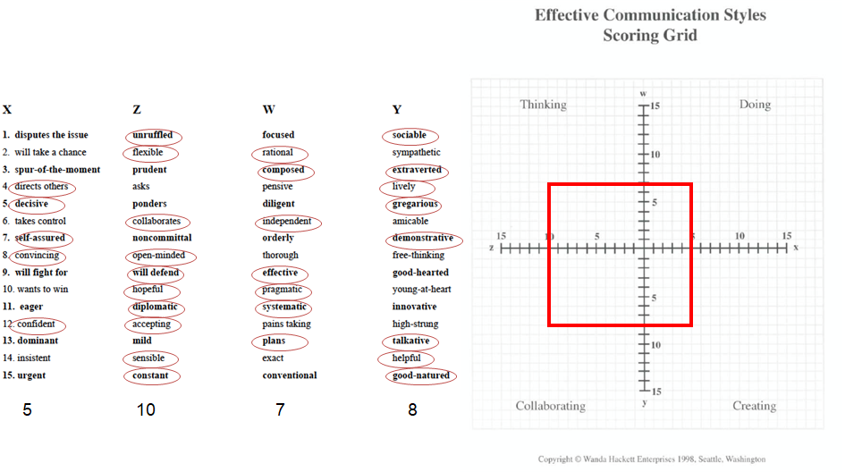
Enhancing Communications
Form: Effective_Communication_Styles_Inventory.pdf

Slide 27
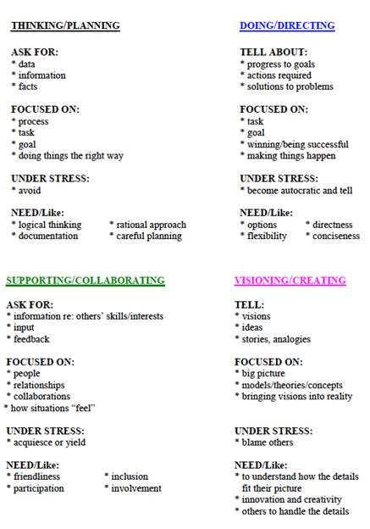
Enhancing Communications
•Likely validating for what you already know
•May vary under different circumstances
•Home
•Work
•Meant to raise awareness of your “go to” style
•Provides language to discuss challenges with mentee

Slide 28
How can I align expectations with my
future PI?
Alignment Phase Checklist/Questionnaire
Mentoring Compacts

Slide 29
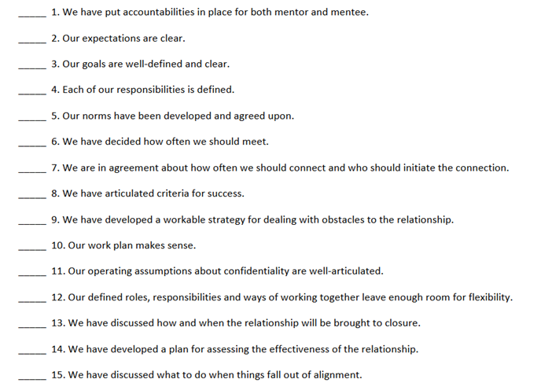
Alignment Phase Checklist/Questionnaire

Slide 30
Finding Your Ideal Mentor for Graduate Studies
Do their research interests align with my own?
Leave room for you to explore new interesting areas you may not have considered
Will they give you the freedom to find a project you like?
What is their mentorship style?
What do you need? Would it be ideal for you to have someone hands off or someone who will be at the bench next to you (PI or lab member)?
Where in their career are they and does that inform their mentorship style?
Ex: senior PI’s are busy often, and travel more vs. someone tenure track PI may have more time initially, but also has tenure track obligations
Does the lab have current students you can talk to? Are there students who rotated in their lab but did not join that you can talk to? Talk to them!
What is the lab culture?
Do they collaborate with others in the department, in the field? Do they encourage taking courses or going to conferences? Is there evidence of work-life balance?
Do students and staff in the lab seem happy?
What is their funding status?
Don’t be afraid to ask this directly. Do they already have a lot of trainees? Will they be able to focus on you?
What is the profile of students who have graduated from their lab?
How long was their PhD? What do they do now? Are former students now in academia as well as industry? Are they open to “alternative” careers besides academia for their trainees?

Slide 31
Mentoring Compacts
Description:
A written document used to articulate expectations between mentors and mentees
Focused on expectations for the working relationship on a daily/ weekly basis
Differs from an Individual Development Plan (IDP) which focuses on the mentee’s short and long-term career plans
Although, this can be used as a starting point for discussions about #labgoals!
Rationale:
Provides documentation of expectations which can be revisited and revised
Serves as a shared reference point for regular progress reviews
Makes invisible expectations, visible
Levels the playing field among mentees
In summary, compacts provides mentors and mentees an opportunity to articulate their expectations and bring them into alignment

Slide 32
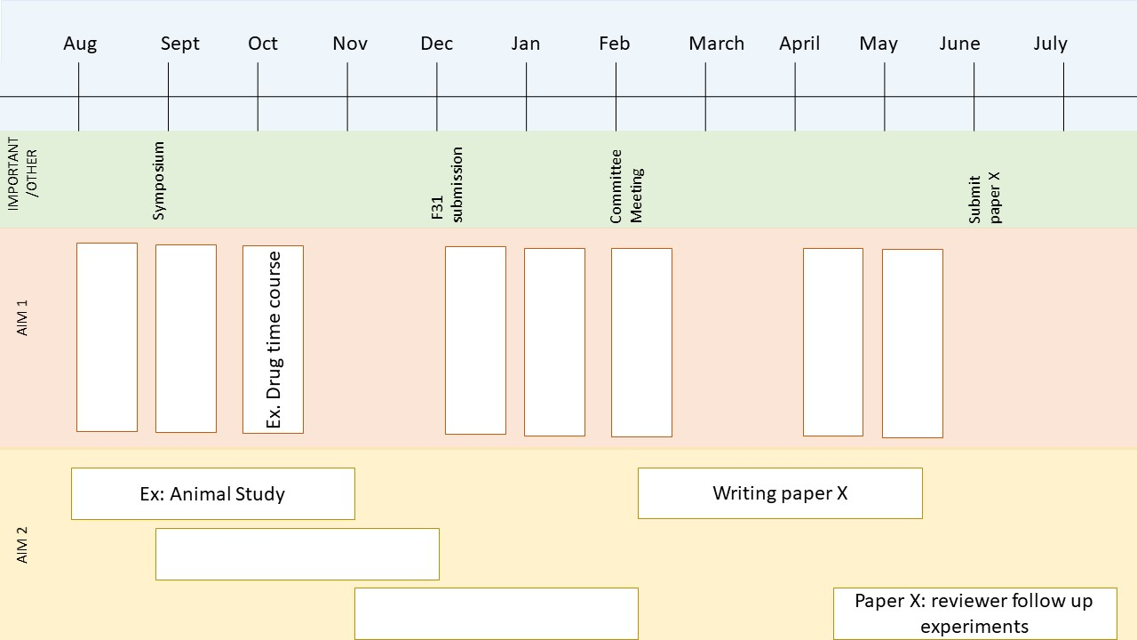
Planning Your Year: Sample Timeline

